Slide 1
MIMICiii Workshop
Jeon Young Seok
Research assistant/Ph.D student
Saw Swee Hock School of Public Health, NUS
Github: Youngseok0001
Email: ephjys@nus.edu.sg

Slide 2
Objectives
Introduction of MIMICiii Schema
Working with the MIMICiii database using SQL
Simple statistical analysis using Python3 in Colab environment

Slide 3
MIMICiii?
A publicly available database released from MIT
De-identified records from Beth Israel Deaconess Medical Center between 2001 ~ 2012.
Contains detailed information of patients’ history (Demographic, Diagnosis, Vital signs, Medication, Notevents, etc)
Only Patients who stayed in(Intense Care Unit) ICU

Slide 4
Some Numbers
27 tables
ADMISSIONS, CAREGIVERS, CHARTEVENTS, …….
46,000 patients
46,520 distinct patients who have gone to ICU at least once
59,000 admissions
A patient may have been admitted to the hospital more than once
60,000 icustays
A single admission case could lead to multiple icustays
5,000 chartevents per admission case
5,000 chart observations(vital, medication, procedure, etc)

Slide 5
MIMICiii Schema
Patients: a list of unique patients in MIMIC
Admissons: a list of unique hospital admissions
Icustays: a list of unique ICU stays.
Diagnoses_icd: ICD diagnoses for patients
Chartevents: Contains all chart data
https://mit-lcp.github.io/mimic-schema-spy/relationships.html

Slide 6
The 3 core tables
Field name | Type
subject_id | INTEGER
gender | STRING
dob | DATETIME
dod | DATETIME
expire_flag | INTEGER
Field name | Type
subject_id | INTEGER
hadm_id | INTEGER
admittime | DATETIME
dischtime | DATETIME
deathtime | DATETIME
Field name | Type
subject_id | INTEGER
hadm_id | INTEGER
icustay_id | INTEGER
intime | DATETIME
outtime | DATETIME
Patients
Admissions
Icustays

Slide 7
Relationship between the three tables
Icustays
Admissions
Patients

Slide 8
Diagnoses_icd and Chartevents
Column | Type
subject_id | int4
hadm_id | int4
seq_num | int4
icd9_code | varchar
Column | Type
subject_id | int4
hadm_id | int4
icustay_id | int4
itemid | int4
charttime | timestamp
value | varchar
valuenum | float8
valueuom | varchar

Slide 9
BigQuery Setup

Slide 10
Working in BigQuery
BigQuery Project
korea-datathon-2018
Google Cloud Storage
Physionet-data:MIMIC

Slide 11
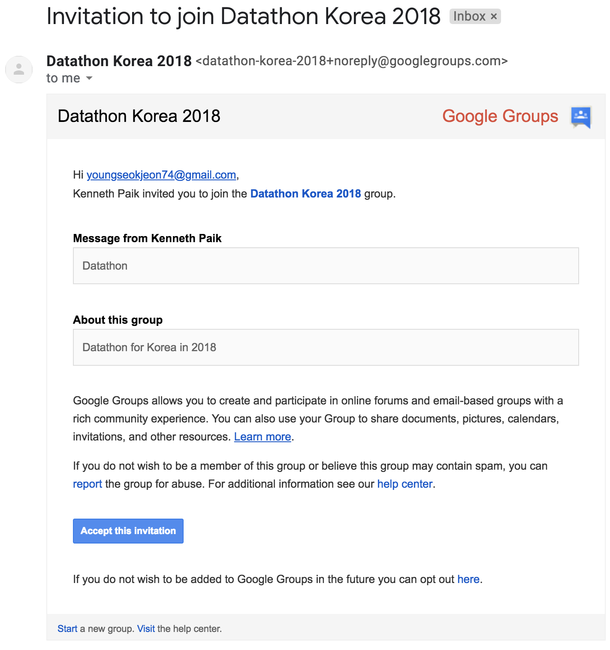
Working in BigQuery
Go to Gmail and accept the invitation
Go to “My group”
You will now see “Datathon Korea 2018”

Slide 12
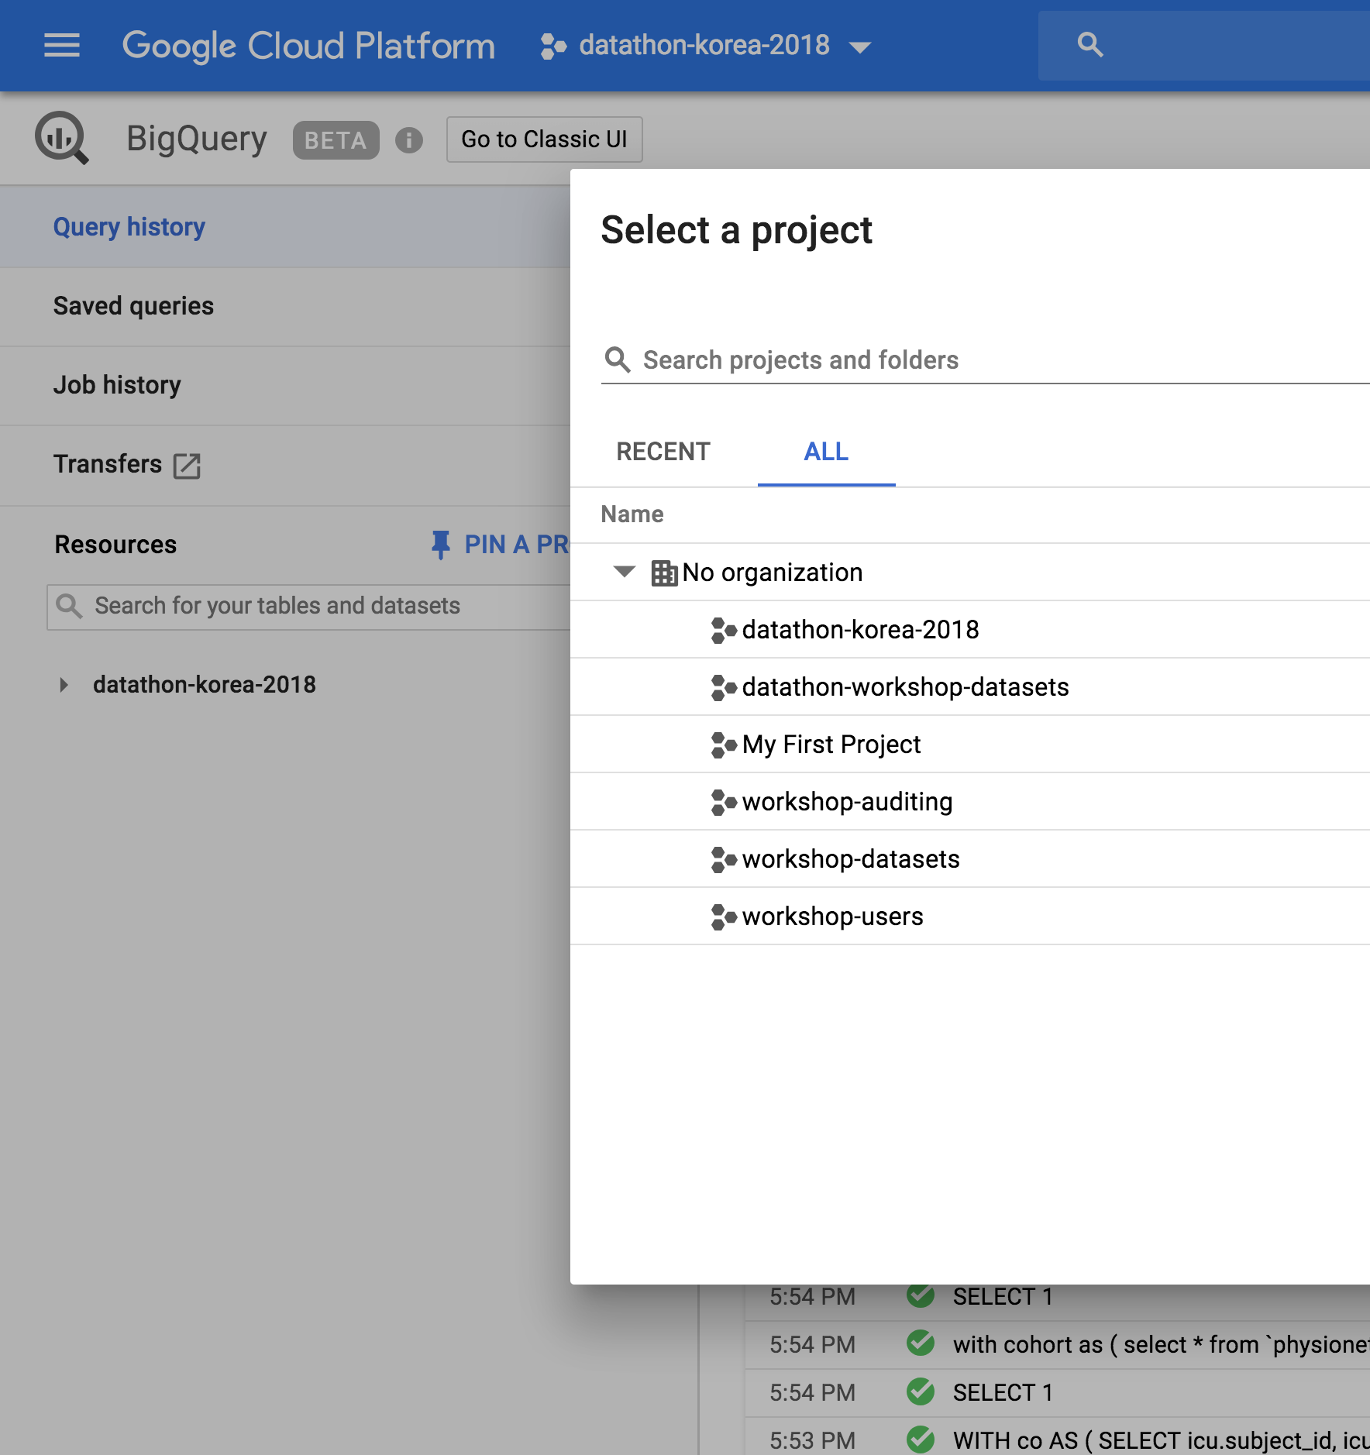
Working in BigQuery
Go to the link below console.cloud.google.com/bigquery
You are now a member of “Datathon-korea-2018”

Slide 13
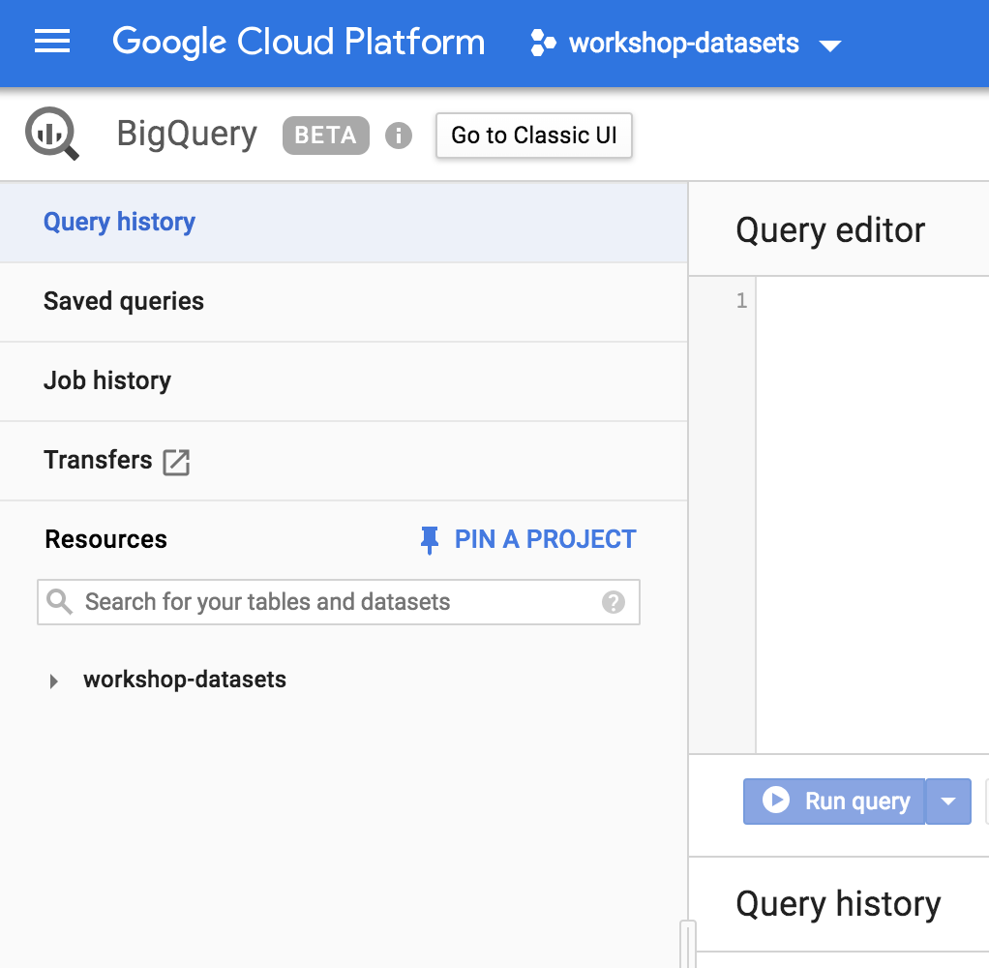
Working in BigQuery
Switch to “classical UI”

Slide 14
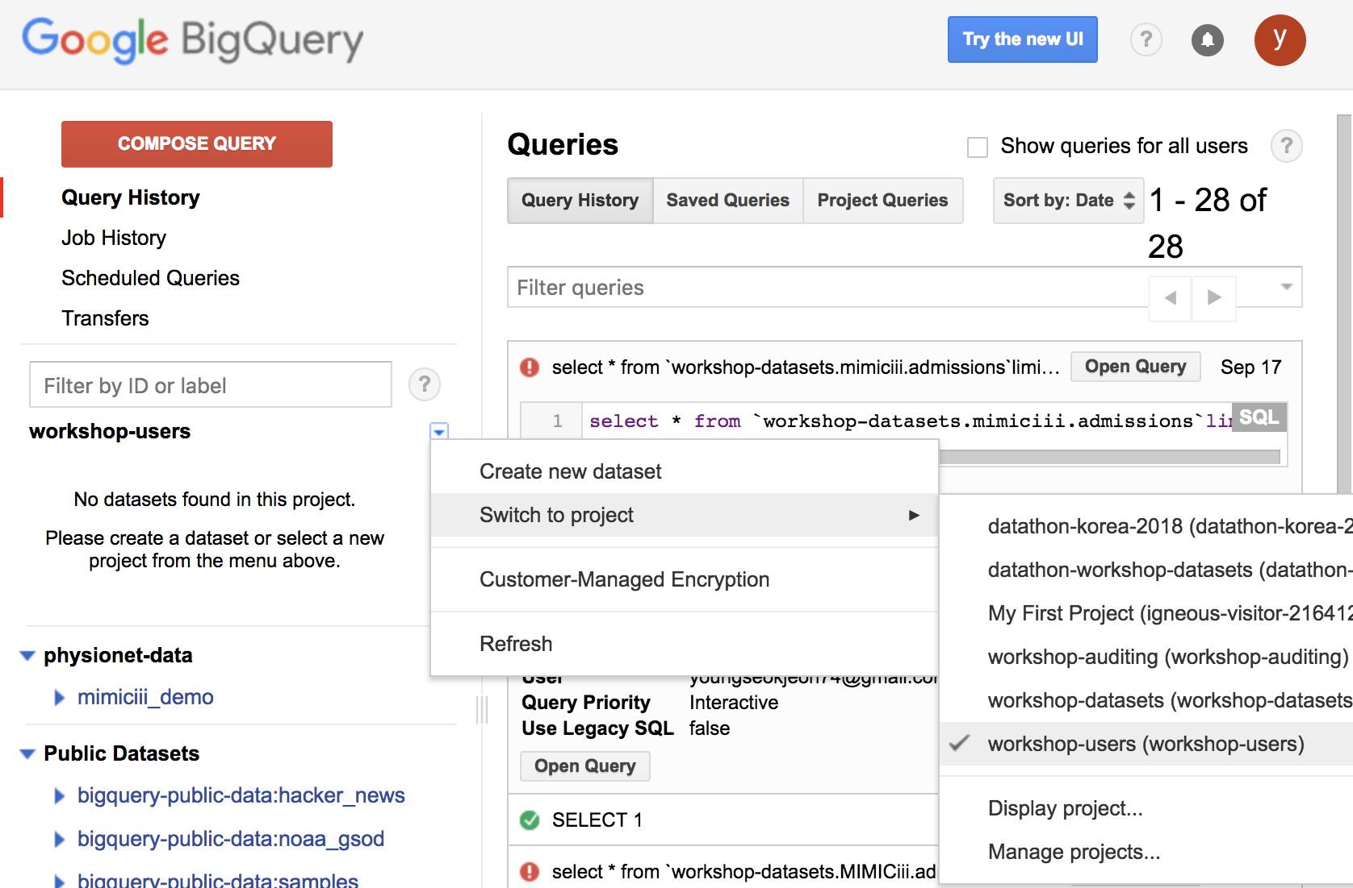
Working in BigQuery
Select “Switch to project”
Select “Display project”

Slide 15
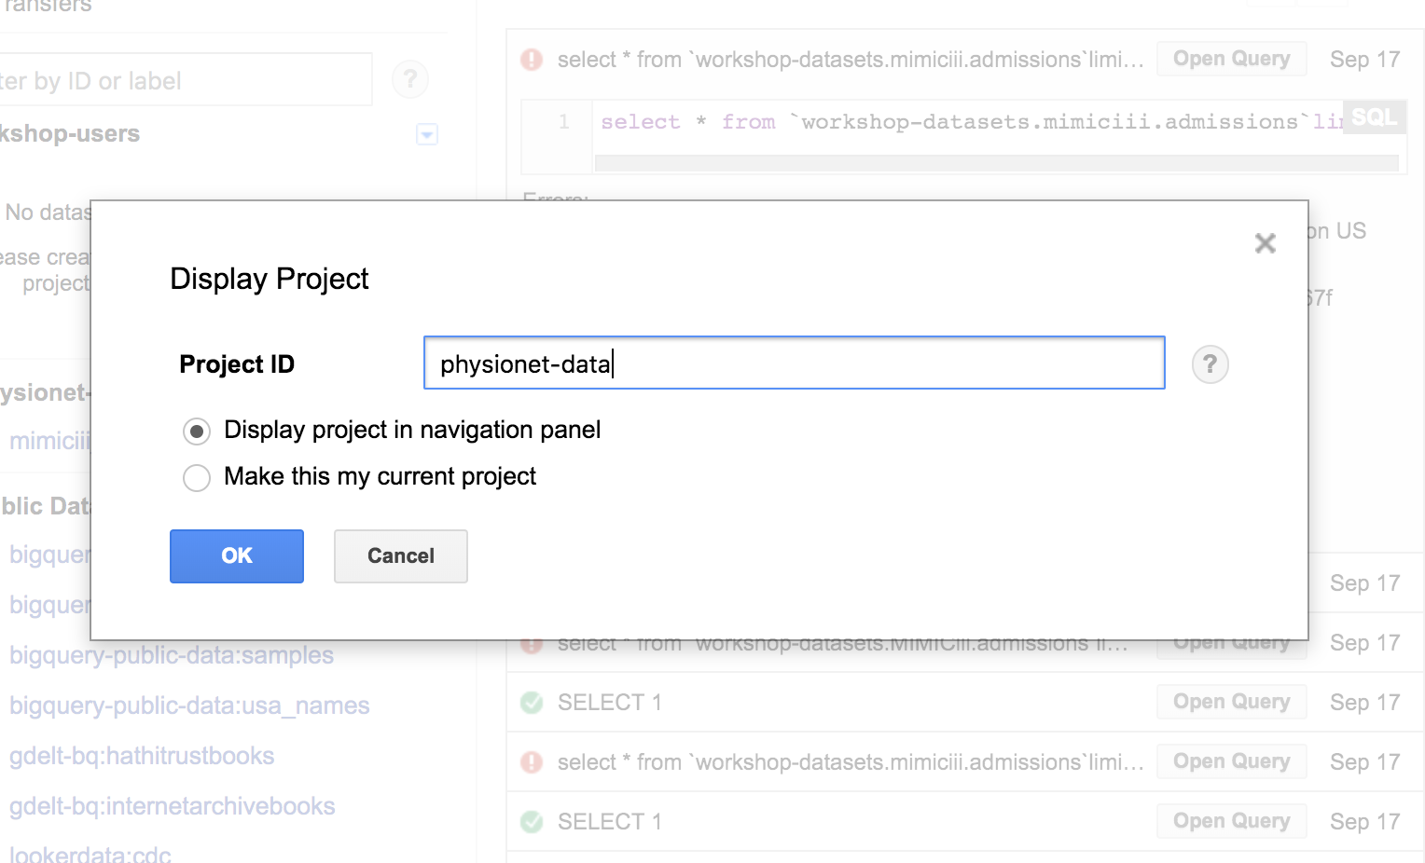
Working in BigQuery
Type “Physionet-data” and click OK

Slide 16
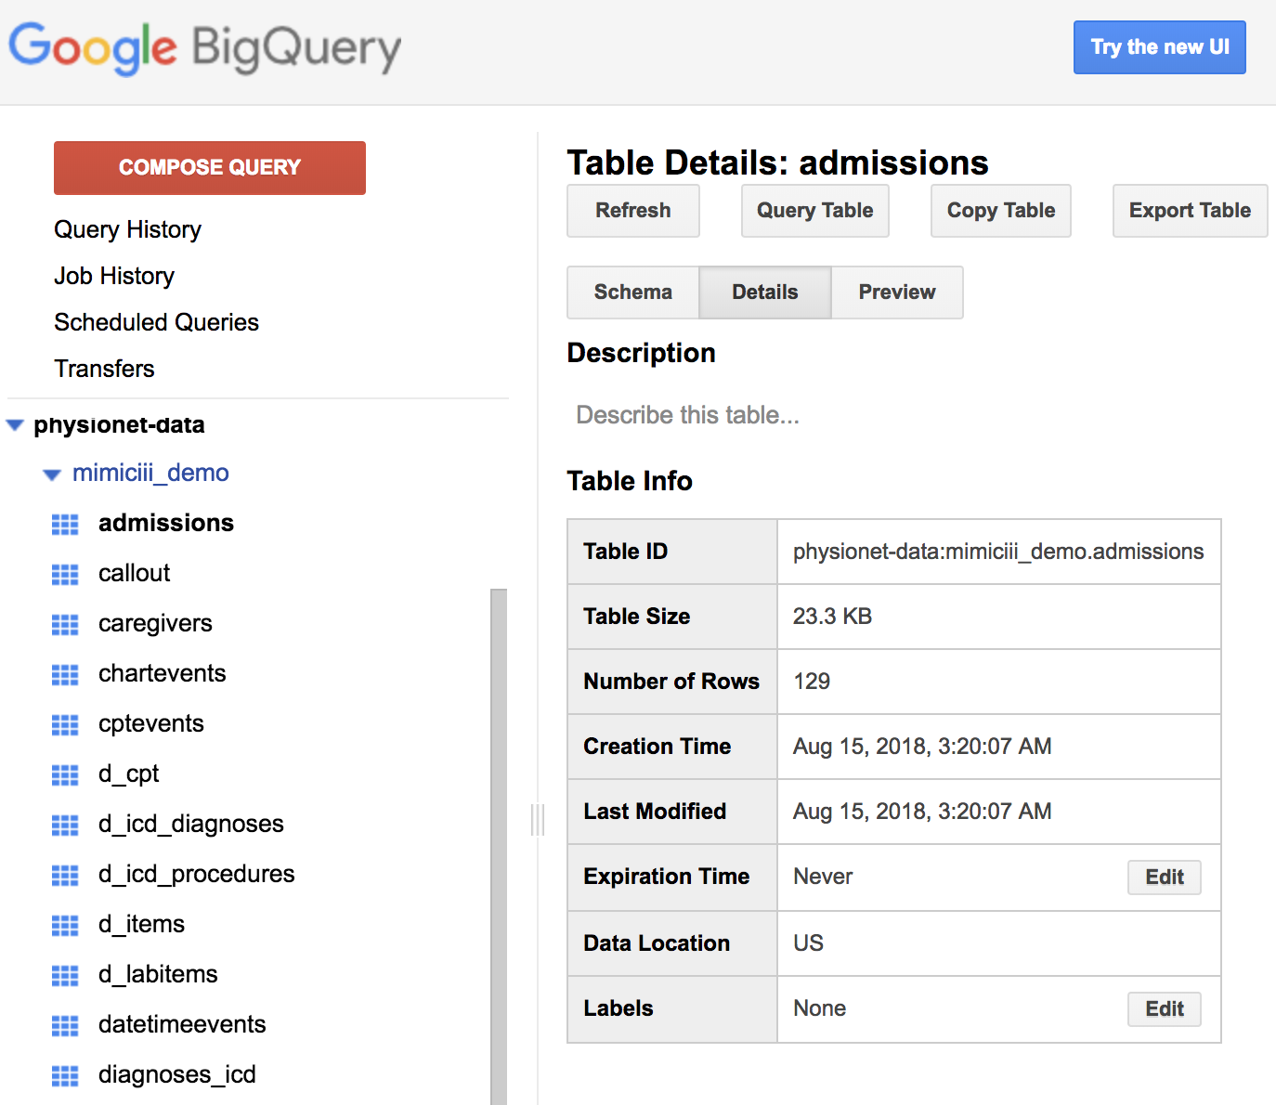
Working in BigQuery
Physionet-data is now available to you
You can now browse tables

Slide 17
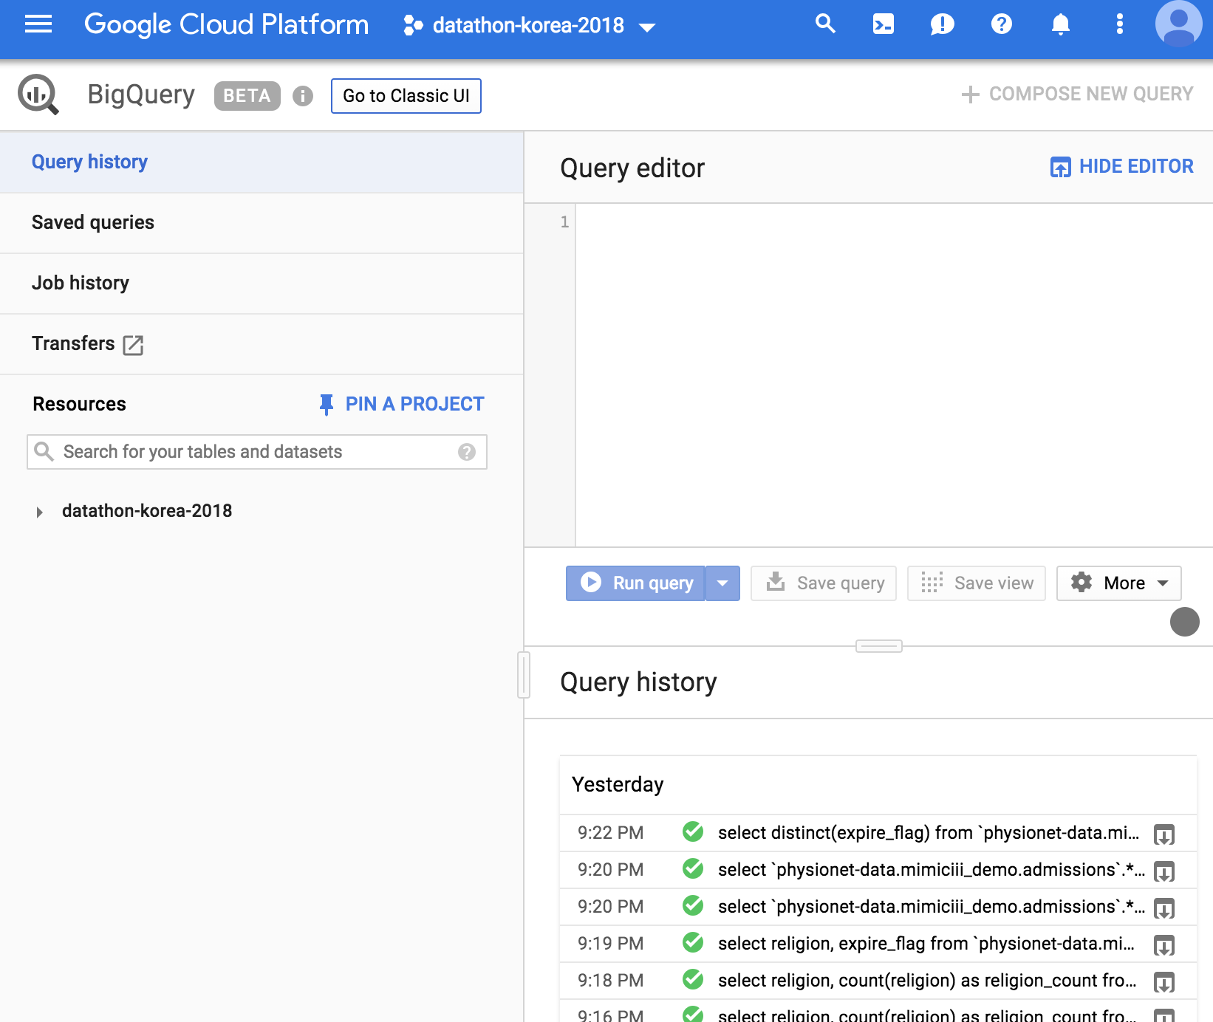
Working in BigQuery
Open a new window
Go to the New UI
Switch your project to “datathon-korea-2018”
Now you can query from mimiciii database

Slide 18
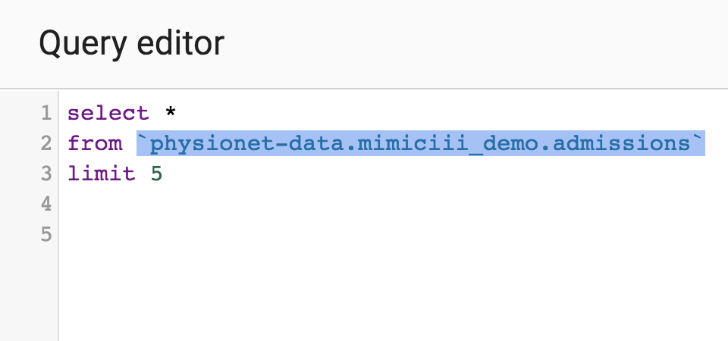
Working in BigQuery
You must specify the source of database!

Slide 19
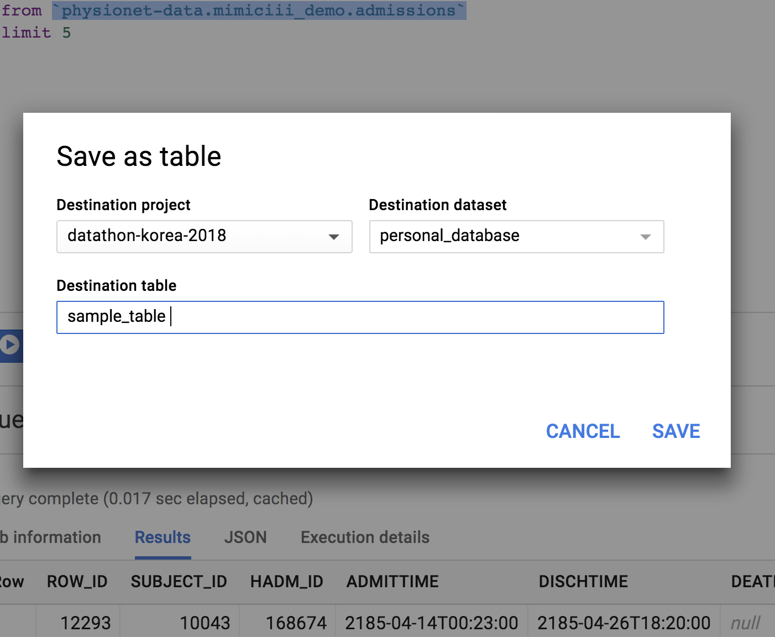
Working in BigQuery
It is also possible to save your query results in your project

Slide 20
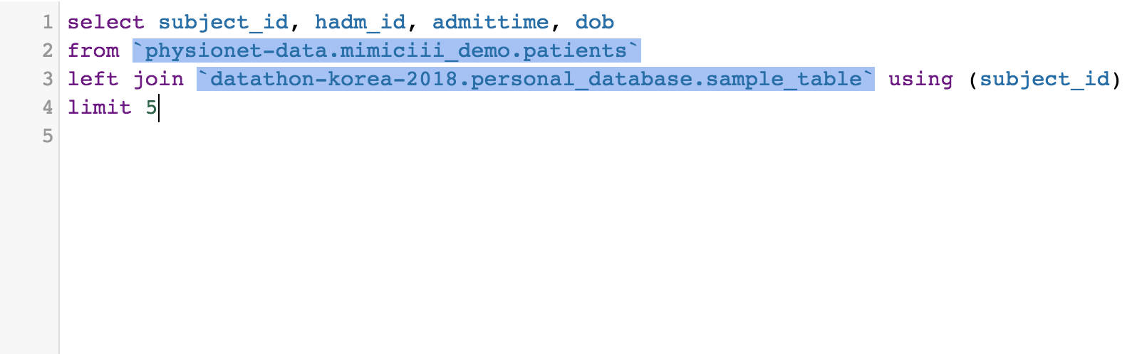
Working in BigQuery
You can even merge your own table with mimiciii tables

Slide 21
Using Colab with BigQuery
Colab is a Jupyter-like service within google cloud sever
It is possible to query database in Bigquery
Your are able to develop machine learning models with pre-installed machine learning packages such as Tensorflow, Sklearn and Pytorch.
Currently only Python is supported

Slide 22
Using Colab with BigQuery
Go to the link below
https://github.com/Youngseok0001/korea-datathon

Slide 23
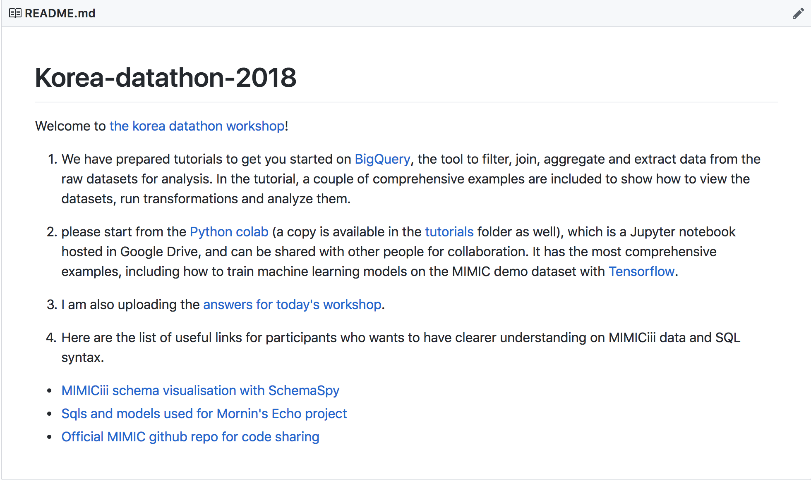
Working in Colab
Please click Python colab highlighted

Slide 24
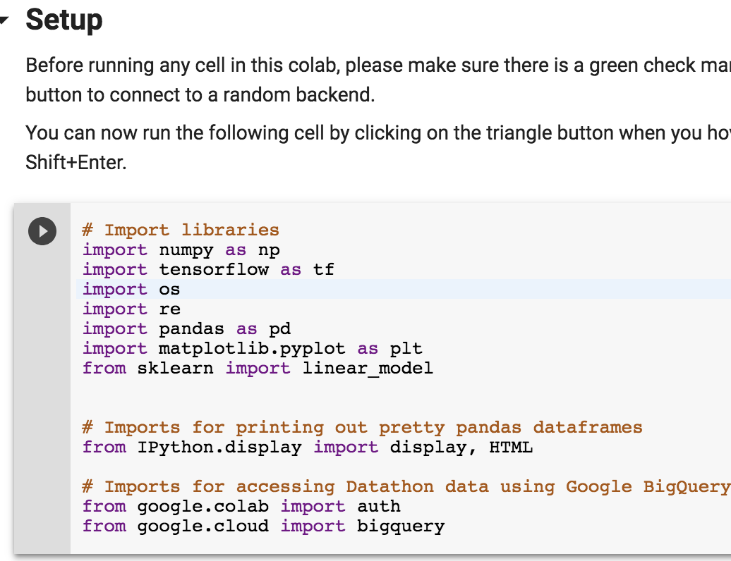
Working in Colab
Let us import necessary libraries first *(please remove `createtableone`library)
Each cell can be executed by pressing Shitt+Enter

Slide 25
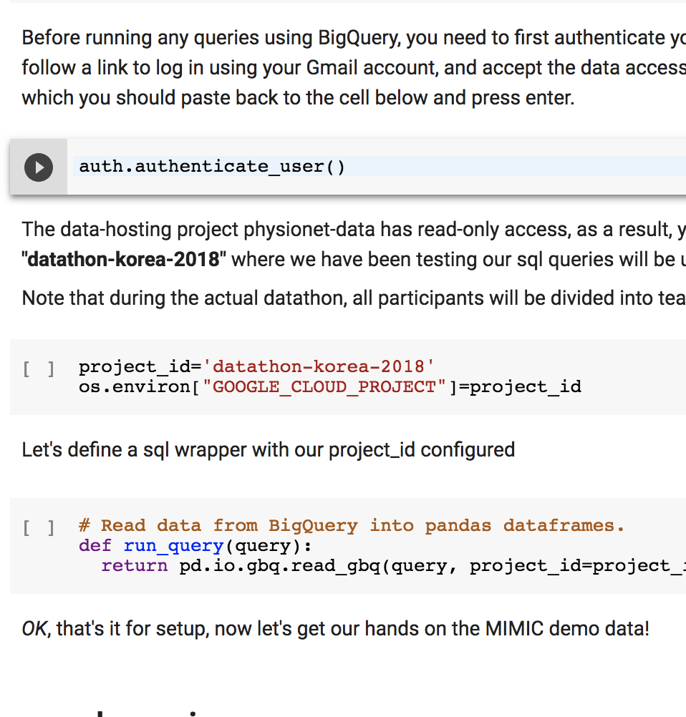
Working in Colab
Run the next three cosecutive cells
You will asked to provide an authentification code
Set your Google project environment
Create a wrapper function for easy query

Slide 26
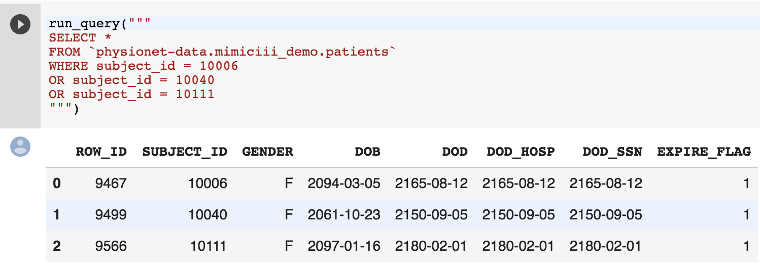
Sample Queries
This query selects all columns from the patients table where subject_id is either 10006, 10040 or 10111.
Since patients table is a table which contains a list of unique subject_id and their basic informations,it will only output 3 observations.

Slide 27
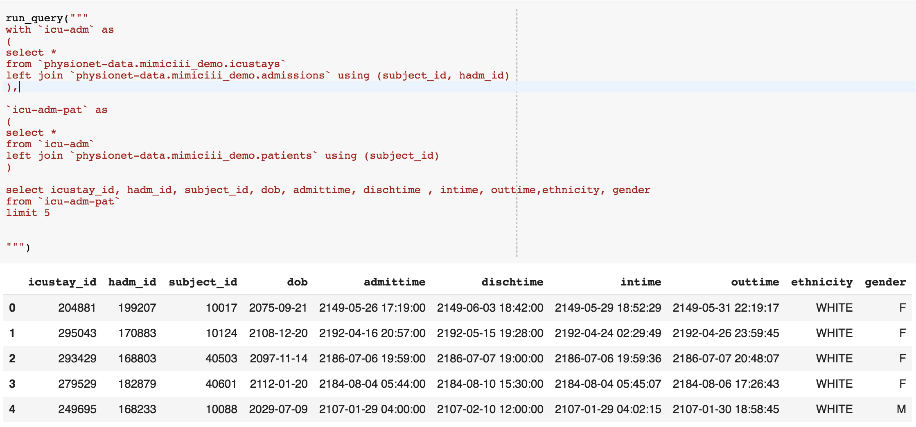
Sample Queries
This query merges the three core tables, “patietns”, “admissions” and “icustays”
Note that intime always happens later than admittime

Slide 28
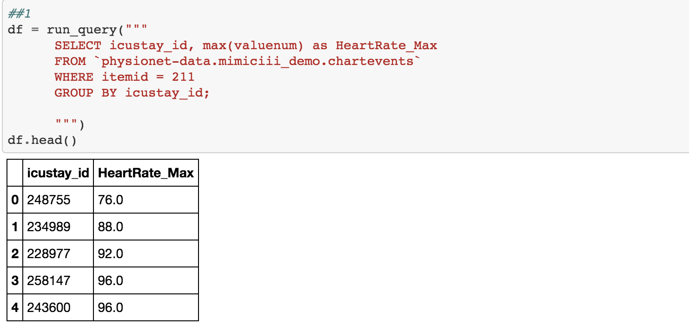
Sample Queries
You will often need to aggregate values over each icustay_id.
The query above uses the “group_by” cluase to get the max HeartRate of each ICU case.

Slide 29
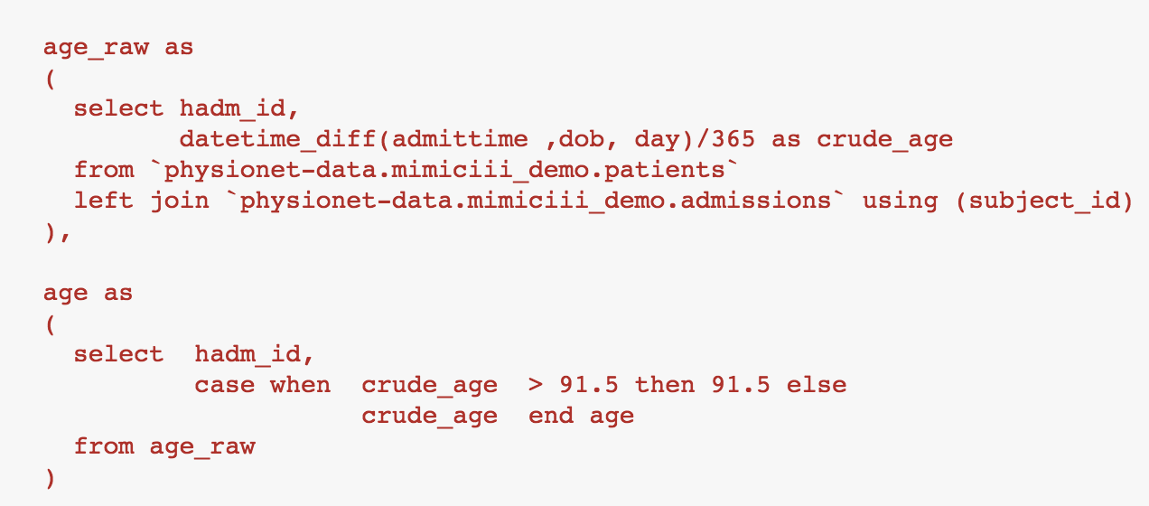
Sample Queries
It is very critical to note that patients with their age above 91.5 are de-identified by shifting their date of birth. You will therefore often see patients to their age well above 200. Please set their age to 91.5

Slide 30
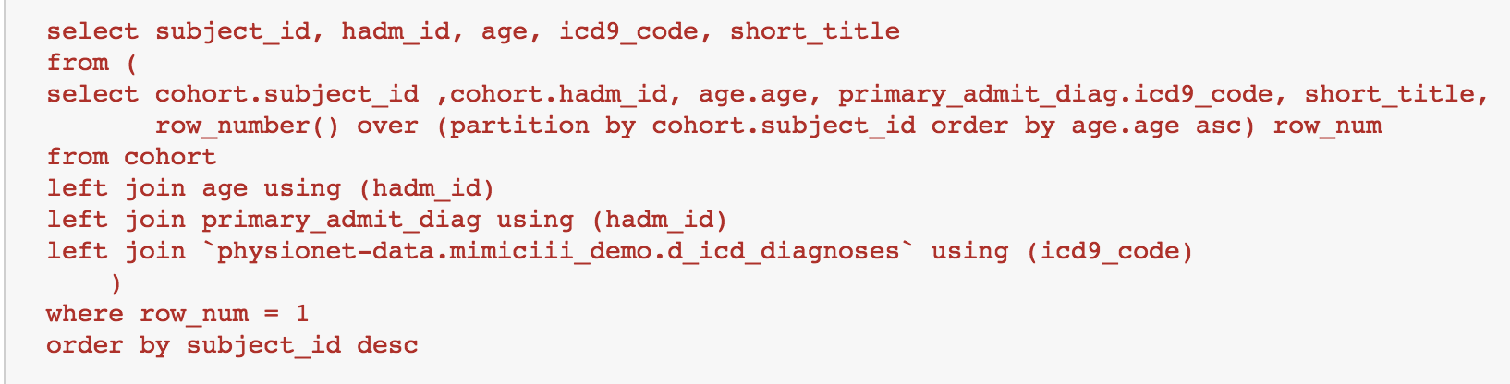
Sample Queries
If your interest is only getting the patients’ primary diagnoses from their first hospital admission, use row_number or rank function to partition subject_id and order them with either their age of admittime.

Slide 31
Sample Queries
If your interest is only getting the patients’ primary diagnoses from their first hospital admission, use row_number or rank function to partition subject_id and order them with either their age of admittime.

Slide 32
General Workflow
The General workflow with MIMICiii data is as follows
Cohort selection
Diagnosis
Labtest Results
VitalSign
Merge all the tables above
The reason for having features from various tables is to adjust for possible confounders.
Please refer to my python script for more details.

Slide 33
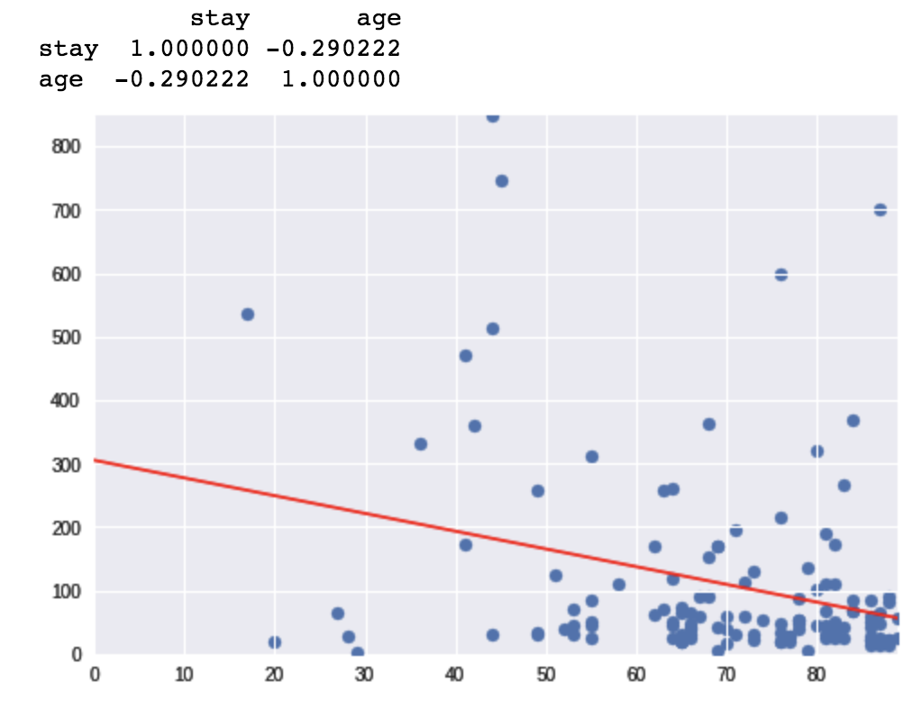
Modeling: linear regression
One possible relation that we will look for is if there is any +ve or –ve correlation between patients’ age and their length of stay in ICU
It can actually be observed that there is a slight relationship
However they are very week, evident from their correlation matrix.

Slide 34
Modeling:Logistic regressions
As shown from the previous plot, It may not actually be suitable to use linear regression as our model because most patients are old in general and thus not much data point is present in younger cohort.
It is therefore not suitable to conclude that they actually follow a liear relationship(It could be non-linear)
Using logistic regression might be a safer choice in this case.
The example given from the script set cases with the length of stay < 1 day as short and long for >1 day
Logistic regression was then used to calculate the OR of staying longer for every unit(year) incerase in age.

